Slide 1
Models of community partnerships for environmental justice , applications and impacts:
Challenges and solutions for supporting community partners
July 14th, 2020

Slide 2
Community-Academic Partnerships: Agenda
3:10 - 4:10 Models of Community-Academic Partnerships: Panel Presentations
UC Davis Center for Regional Change: Jonathan London, UC Davis; Phoebe Seaton, Leadership Counsel for Justice and Accountability
Water Equity Science Shop: Clare Pace, UC Berkeley
Future Bay Initiative: Derek Ouyang, Stanford University, and Belen Seara, San Mateo County Health
4:10 - 4:30 Community Partner Perspectives
Violet Saena, Climate Resilient Communities Program, Acterra
Esperanza Vielma, Environmental Justice Coalition for Water
Edgar Garibay, Tuolumne River Trust, Modesto Office
4:30 - 4:50 Breakout groups: Imagining Solutions
4:50 - 5:00 Wrap-up and next steps

Slide 3
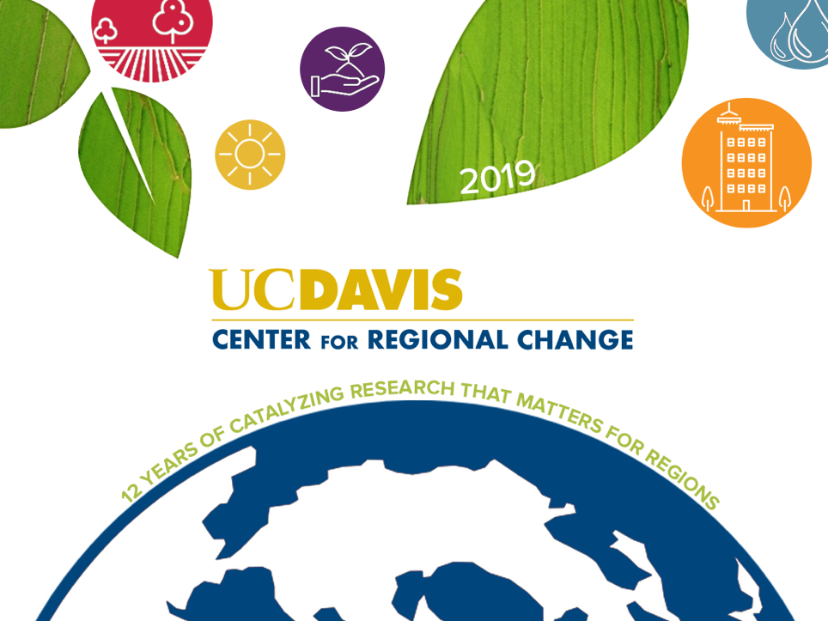
Notes:
Thank you for the opportunity to share this overview of the Center for Regional Change-- familiar to some of you and new to some. We are excited to begin our second 5 year review.

Slide 4
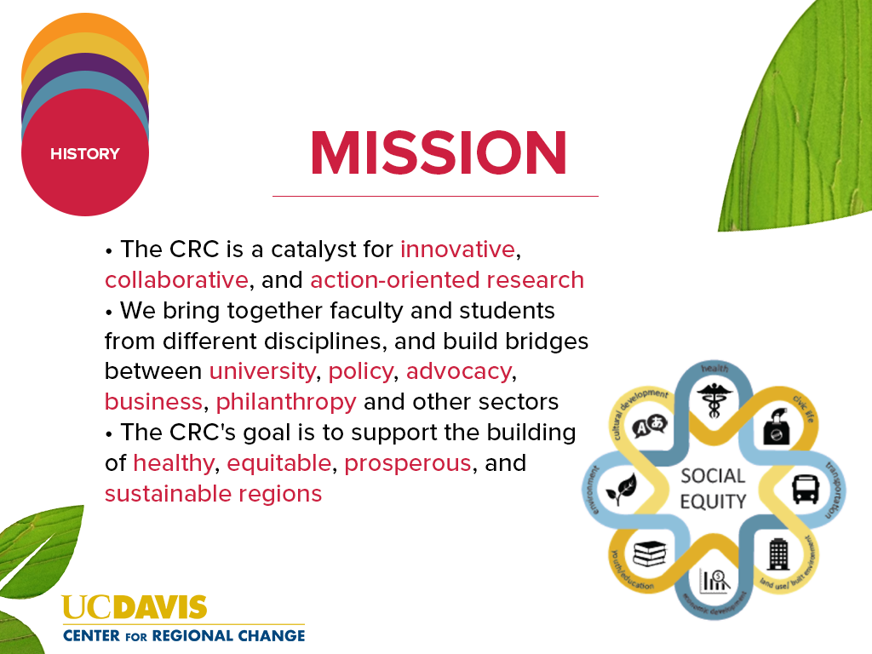
Notes:
The CRC’s work is based on the understanding that one cannot understand, or improve any one system unless you understand and act upon its connections to the many other systems with which it interacts. To achieve a healthy region, strategies to address housing, transportation, land use, education, the economy and other issues is needed. We also understand that change does not stop at city or county boundaries so a regional approach is needed.
One of the unique aspects of the CRC is how we place social equity in the center of what we do and how we do it. We think carefully about how certain populations are over-burdened and under-resourced and excluded from decision-making -and we inform strategies to achieve equitable change.

Slide 5
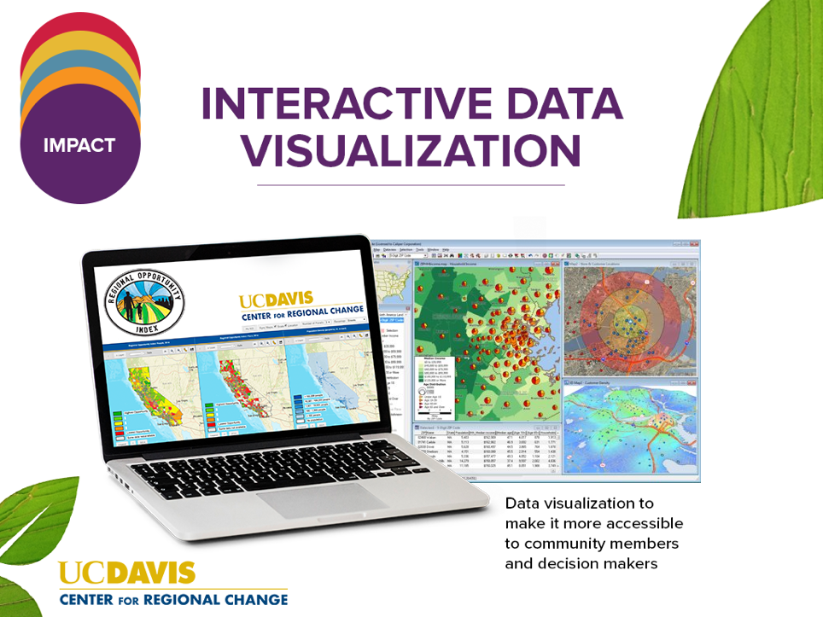
Notes:
Developed with banks to help guide their community reinvestment act strategies, they have also been used by public agencies and community organizations and youth leaders. PIs: Chris Benner, Nancy Erbstein, Anne Visser

Slide 6
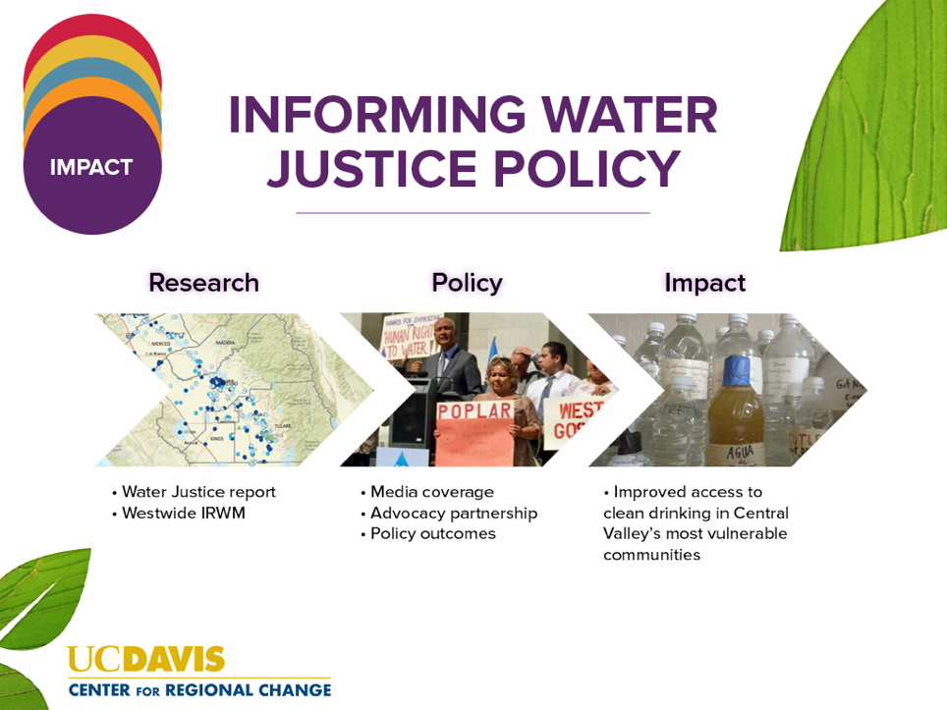
Notes:
One example is a recent water justice report we conducted in the San Joaquin Valley. We produced a pathbreaking analysis of the accessibility of clean drinking water in the region, that has helped inform key policies such as the $130million/ year Safe and Affordable Drinking Water Fund (signed by Governor Newsome in July and several bills on improving water systems in disadvantaged communities. One notable element of the drinking water fund is the unusual coalition of the ag industry (including members of the DAC), environmentalists and EJ advocates.

Slide 7
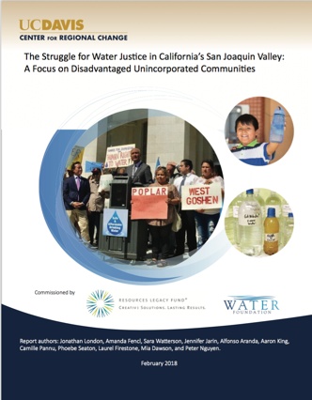
The Struggle for
Water Justice:
A Focus on Disadvantaged Unincorporated Communities

Slide 8
Community-University Partnerships
Co-Authors: Amanda Fencl, Sara Watterson, Jennifer Jarin, Aaron King, Alfonso Aranda, Camille Pannu, Phoebe Seaton, Laurel Firestone, Mia Dawson, Peter Nguyen, Krystyna von Henneberg
Community Partners: California Rural Legal Assistance, Clean Water Action, Community Water Center, Environmental Justice Coalition for Water, Leadership Counsel for Justice and Accountability, Policy Link
Funding: Water Foundation, Resources Legacy Fund
Notes:
Important to acknowledge co-authors and partners in this collaborative project – several of whom are here – Amanda Fencl, Mia Dawson, and Alfonso Aranda
Important to have academic and community partners
Origin was request from foundations to provide analysis of water access in DUCs to inform policy campaigns on water justice.

Slide 9
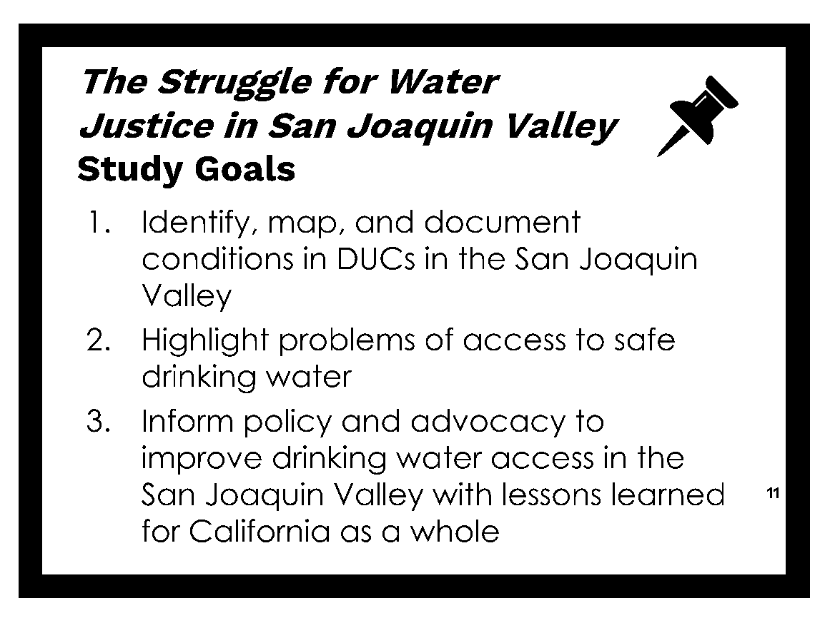

Slide 15
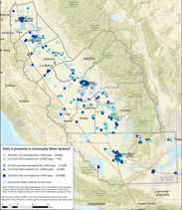
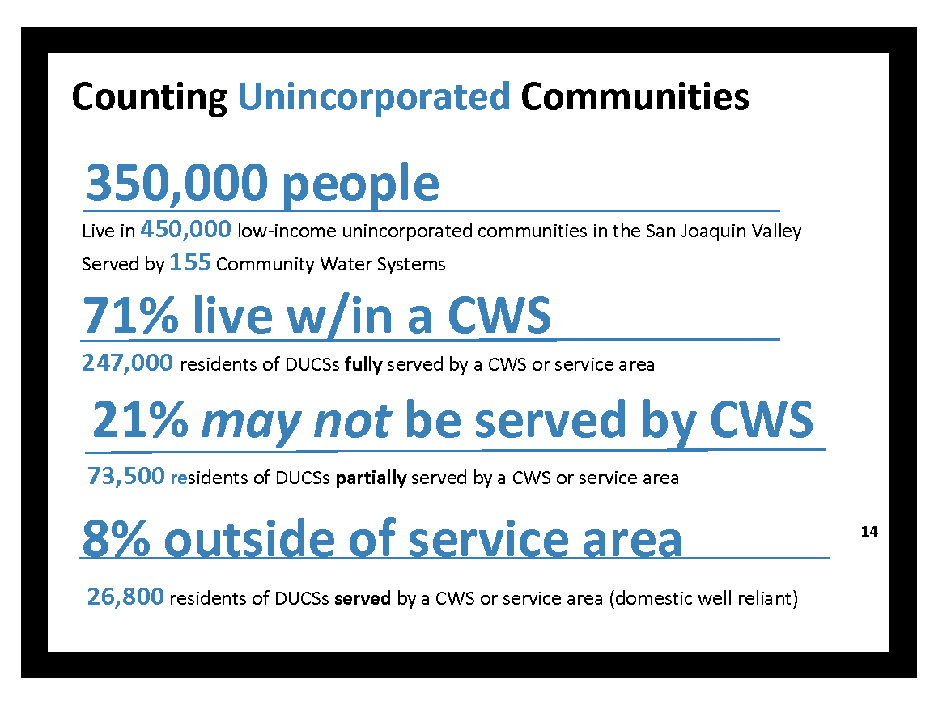

Slide 18
How close is safe water?
Proximity of DUCs to In‐Compliance Public Systems
Notes:
Don’t say here – say on following slide
66% of DUC residents w/o access to safe drinking water live in close proximity (<1 mile) to a system that does or could provide safe water with proper investments
44% of DUCs within 500ft and 22% within one mile

Slide 19
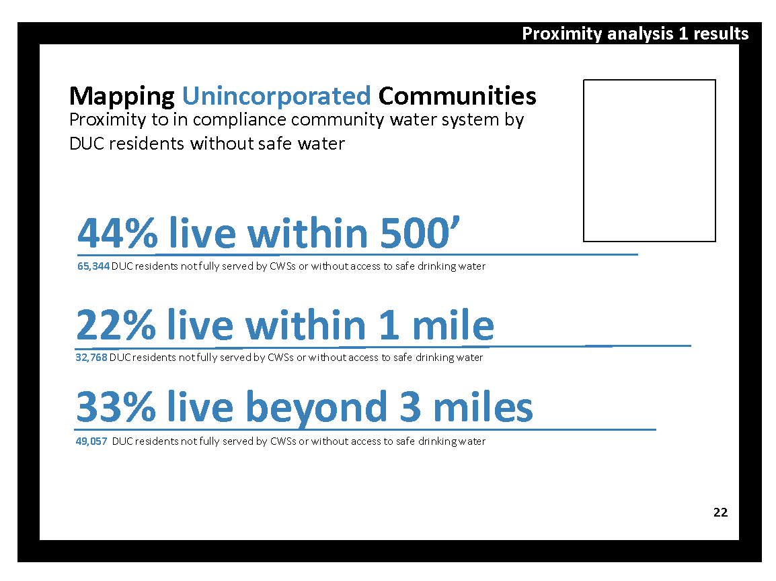
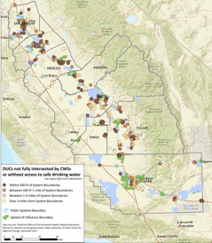

Slide 20
Study Recommendations
Improve enforcement of existing laws on water system consolidation and annexation
Enforce city/county land use and annexation policies
Expand and sustain funding for existing water systems and new connections for DUCs
Enhance and coordinate data systems
Expand study (statewide, waste water, cost, private wells, small systems)

Slide 21
1. Improve enforcement of existing laws on water system consolidation and annexation
Focus on extending service (not just existing systems)
Expand consolidation mandates
Enhance community petition power
Incentives/ requirements on new extensions
Non-physical consolidation for dispersed communities

Slide 22
2. Enforce city/county land use and annexation policies
Cities/counties must assess needs of DUCs in General Plans
Protect interests of DUCs in municipal/ district annexations
Address discriminatory and historical land use patterns

Slide 23
3. Expand and sustain funding for existing water systems and new connections for DUCs
Funding for Operations and Management
Accessible to DUCs
Safe and Affordable Drinking Water Fund

Slide 24
How Has The Report Been Used?
Educate and Elevate
  Increased understanding of the phenomena of unsafe water in the San Joaquin Valley and proximity of places without water to areas / infrastructure delivering safe water
Support State Policy Efforts
  Expanded and improved policies to support consolidation
Support State Policy and Program Efforts
    Some jurisdictions are moving consolidation programs, plans and policies
Shift state administrative efforts
  Increased efforts to move forward consolidation investments and policies

Slide 25
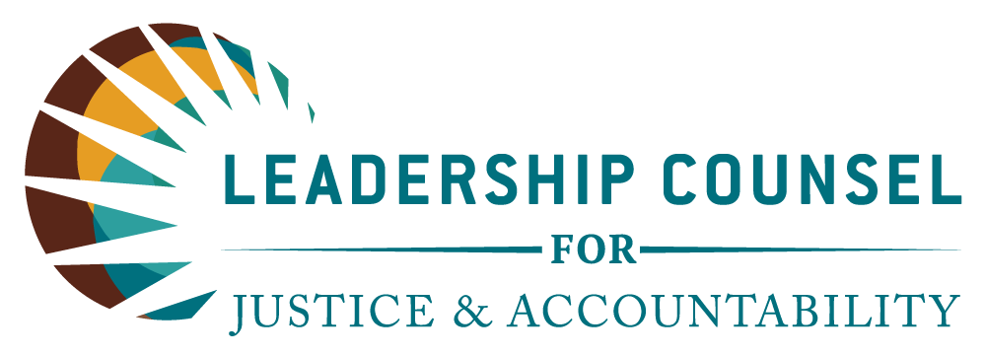
“Work alongside the most impacted communities to advocate for sound policy, eradicate injustice and secure equal access to opportunity regardless of race, income, wealth or place.”

Slide 26

Our work is characterized by our partnerships with community residents and organizational partners and is focused by our goals of:
Ensuring that processes, programs and policies do not disadvantage, but rather benefit, low income communities and communities of color
Holding decision-makers accountable to these communities
Ensuring inclusion of rural regions in program and decisions related to land use, water, energy, environment, climate change, transportation, housing, economic development and public investment
Shifting the culture of decision making to one that is inclusive, equitable, transparent and just
5. Co-powerment

Slide 27
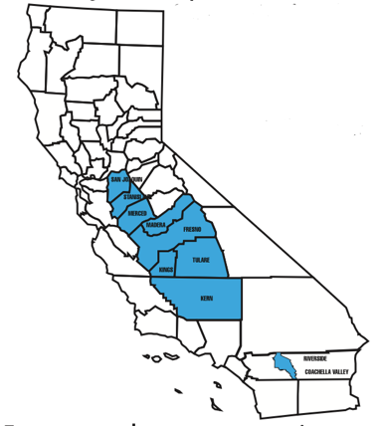
Where we work

Slide 28
Program Areas
Transportation
Climate Change & Air Quality
Water & waste water
Land Use
Housing
Infrastructure
Energy
Economic Development
Environmental Justice
Civil Rights
Effective Democracy
Government Accountability
Equitable investment
Equitable Development

Slide 29
How do we reach our goals?
Community Organizing
Communications and Researchers
Co-Powerment
Policy Advocacy
Legal Representation

Slide 30
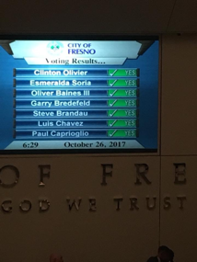
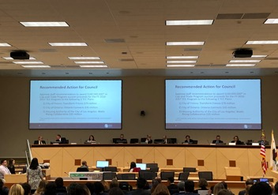
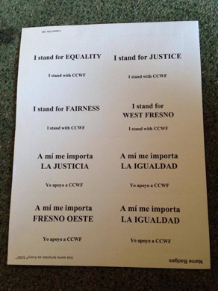
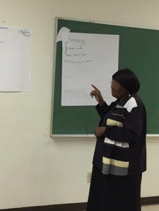
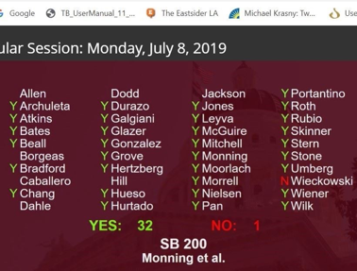
Policy Advocacy
and Organizing

Slide 31
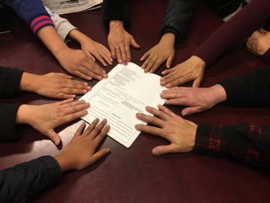
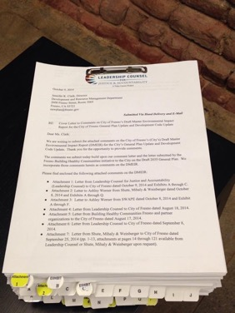
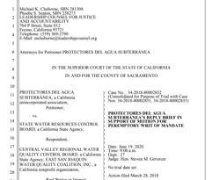
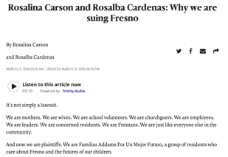
Legal Representation and Organizing

Slide 32
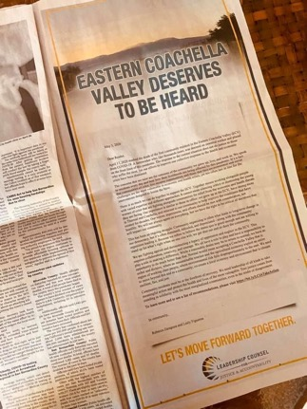
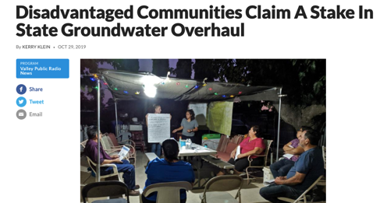
Communications, Research, Messaging, and Organizing

Slide 33
Research in Action – A Few Examples
Groundwater Sustainability and Drinking Water Protection
AB 3312 – Annexation and Service Provision
Wastewater and Service Exclusion

Slide 34
Community-University Partnerships and Water Justice
Jonathan London (UC Davis Center for Regional Change
Phoebe Seaton (Leadership Counsel for Justice and Accountability)

Slide 35
University-Community Partnerships
Valuing multiple types of knowledge
→ More powerful together
Interdisciplinary
→ Transdisciplinary (new paradigms and applications of knowledge)
Research to inform advocacy
→ Action implications developed by advocates

Slide 36

The Water Equity Science Shop
A Community Academic Partnership
Clare Pace, PhD, MPH
July 14, 2020
CPace@Berkeley.edu
Notes:
-

Slide 37
Outline
  Structure of the WESS
  Conceptual Framework
  The Drinking Water Tool
  Lessons Learned
  Impacts
  Next Steps

Slide 38
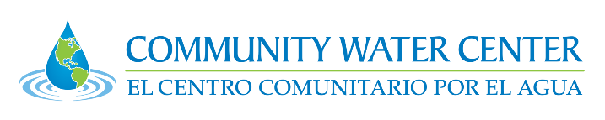
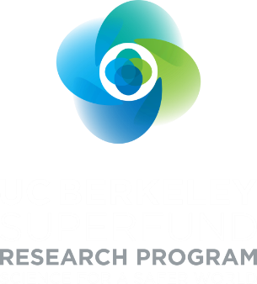


Water Equity Science Shop (WESS)
Structure of the WESS
Support community organizations, research, and policy

Slide 39
Conceptual Framework
Paradigm Shift
in Design Process
Traditional Design Process
CBPR Design Process
Experts Community
Experts
Community
“We know what you need”
“Let’s develop solutions together”
international-humanitarian-capstone-design-project-option-a-model-for-success.pdf

Slide 40
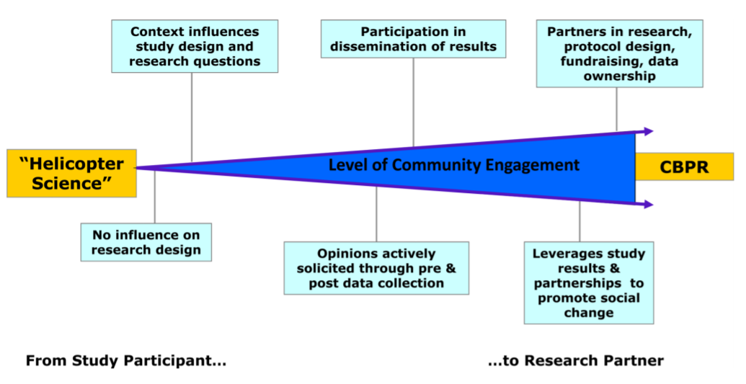
The Conceptual Framework
Power concentrated
Power shared
Balazs, Morello Frosh: The three R’s: how community based participatory research strengthens relevance, reach, and rigor of science. 2013. Environ Justice. February; 6(1)

Slide 41
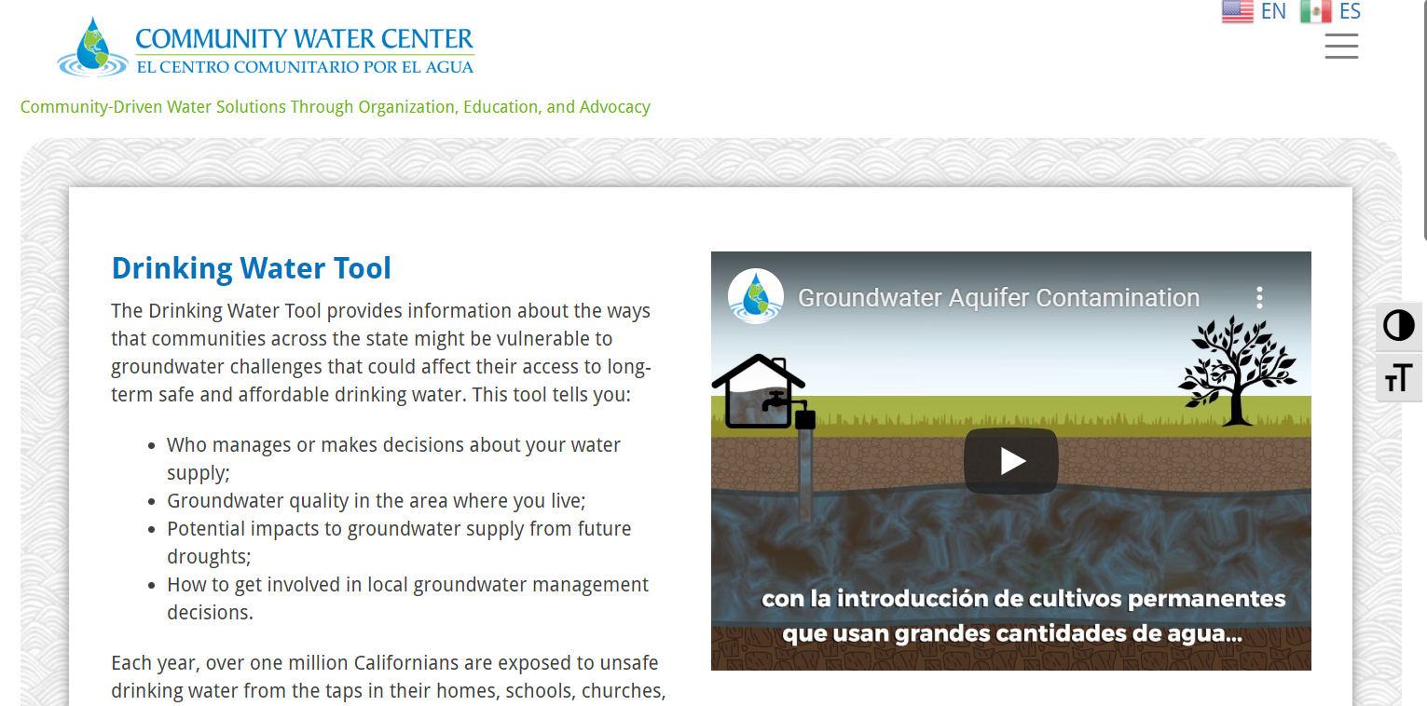

Slide 42
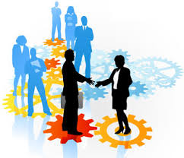
Lessons Learned:
The partnership continues to evolve
Building relationships
  Early stages: Informal collaboration
  Current stage: more institutionalized approach
  Community partnership questionnaire

Slide 43
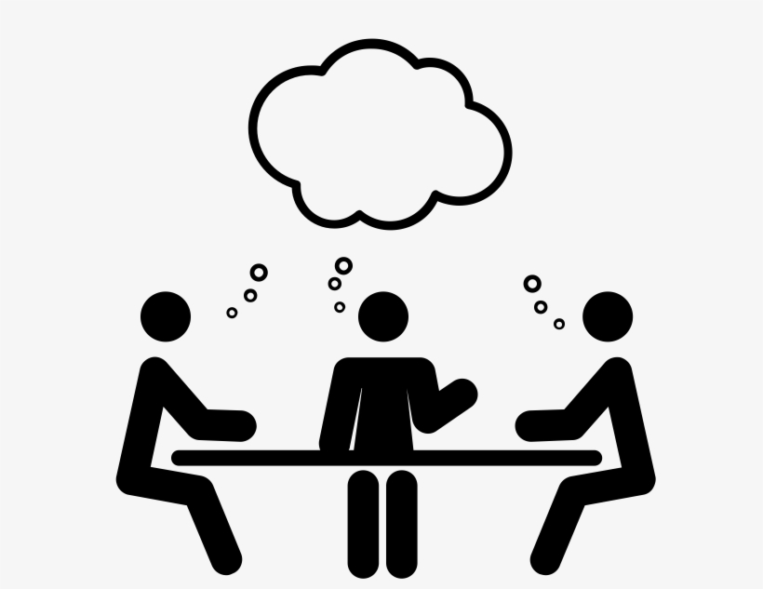
Lessons Learned:
Coordinated efforts early on
Collaborative planning
Close coordination in early stages of funding
Discussions with CWC go directly into the proposal
Image credit: Jessica Lock, Noun Project

Slide 44
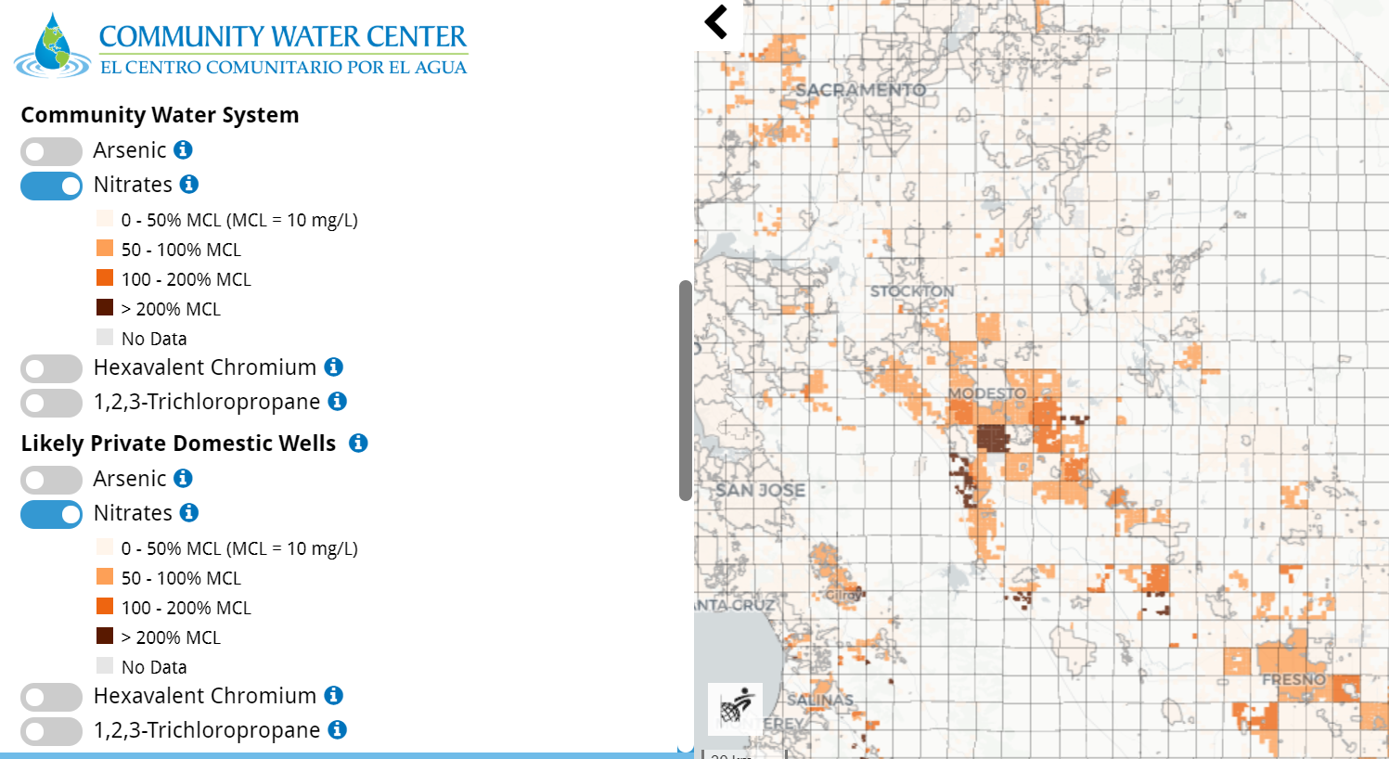
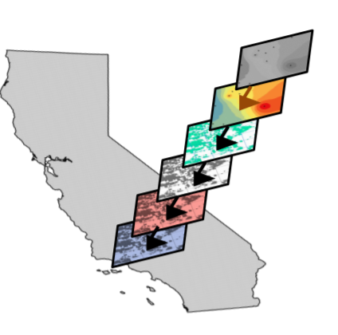
Lessons Learned:
Collective decision making and compromise
Data layers -> Data display

Slide 45
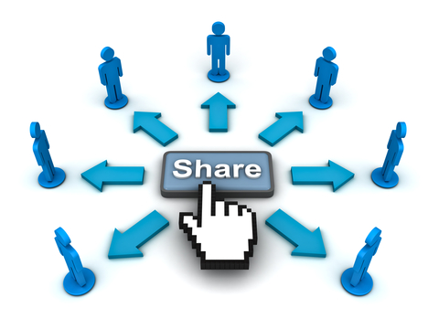
Lessons Learned:
Data ownership
Timing of data release

Slide 46
Impacts:
Supporting The Human Right to Water (AB 685)
  Groundwater Sustainability Agencies - developing Groundwater Sustainability Plans (GSPs)
  Sustainable Groundwater Management Act (SGMA) (AB 1739, SB 1168, SB 1319)
  Cal EPA OEHHA – tracking progress
  Achieving the human right to water (AB 685)
  Identifying disadvantaged communities (Cal EnviroScreen Tool (SB 535))
  CA State Water Boards
  Drinking Water Needs Assessment (SB 682)
  Aquifer risk study (Safe and Affordable drinking water fund (SAFER) (SB 200))

Slide 47
Next Steps
  Incorporating feedback
  Peer reviewed publication
  Planning for future collaborative grants
  Improving the quality of the partnership

Slide 48
“Both thinking and facts are changeable. If only because changes in thinking manifest themselves in changed facts. Conversely, new facts can be discovered only through new thinking” – Ludwick Fleck¹
Contact information: Cpace@Berkeley.edu
The Water Equity Science Shop: https://nature.berkeley.edu/morellofroschlab/about/
Community Water Center: https://www.communitywatercenter.org/#gsc.tab=0
Drinking Water Tool: https://drinkingwatertool.communitywatercenter.org/
1. Fleck, L. Genesis and Development of a Scientific Fact. Chicago, IL: University of Chicago Press, 1970 (1935); 50-51.

Slide 49
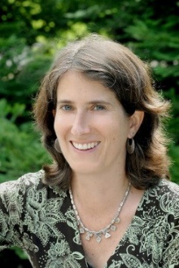
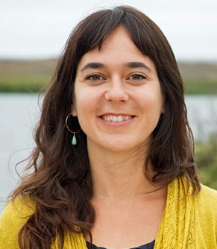
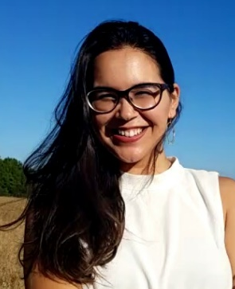
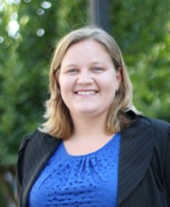
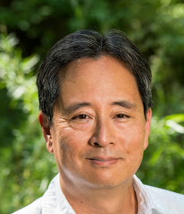
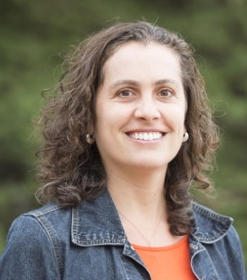
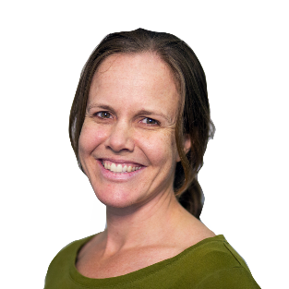
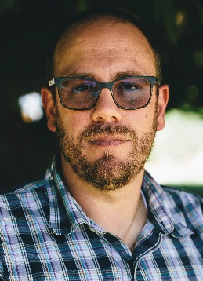
Water Equity Science Shop Community Water Center
Rachel Morello-Frosch
UC Berkeley (UCB)
Co-lead
Carolina Balazs
OEHHA
Co-lead
Lara Cushing
San Francisco State University, UCB
Co-lead
Clare Pace
UCB
Postdoc
Adriana Renteria
Amanda Fencl
David Okita
Collaborators:
Community Water Center
UC Berkeley
San Francisco State University
CA Office of Environmental Health Hazard Assessment
Heather Lukacs
Ryan Jensen
Funders: NIEHS Superfund Program, Community Engagement Core; Department of Water Resources

Slide 50
Case Study:
Stanford Future Bay Initiative + SMC Health
Derek Ouyang
Belen Seara
7/13/20

Slide 51
Outline
Brief intro: Belen’s organization, SMC Health
Brief intro: Derek’s program, Future Bay
Three major challenges Belen and Derek want to highlight
  Authenticity: The need for practitioners within academia, and the intellectual/cultural humility to understand and target root causes
  Accountability: Finding the sweet spot of student engagement, and sustaining partnership through institutional change
  Autonomy: The need for discretion to adapt as needed, from all sides
Conclusion: steps toward structural solutions at Stanford

Slide 52
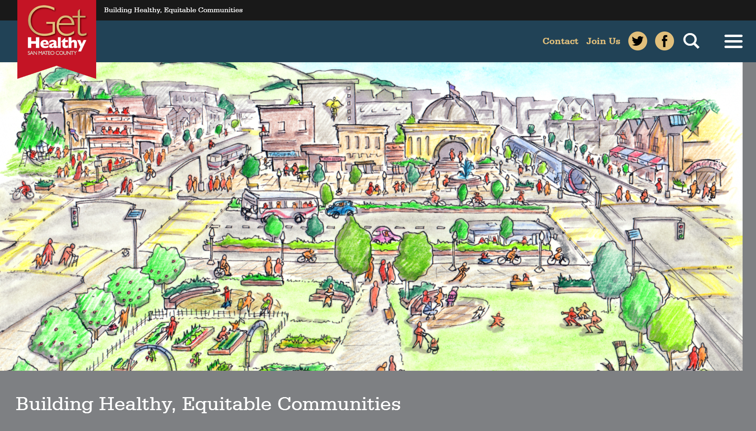

Slide 53
Research Steering Committee
bay.stanford.edu
RESEARCH
Researchers mentor course projects; students gain exposure to skills and opportunities in academic research
Researchers gain exposure to real-world stakeholders, problems, and data; community partners guide problem-focused research
Principal Investigators
Prof. Jenny Suckale
Prof. Gabrielle Wong-Parodi
Research Assistants
Postdoc Student
External Partners
Committee
Nonprofit
City
County
Agency
Industry
EDUCATION
PRACTICE
Education Steering Committee
Students
Practice Steering Committee
Teaching Assistants
Derek Ouyang
Partnership Navigator
Students learn from and support community partners;
partners provide career pathways

Slide 54
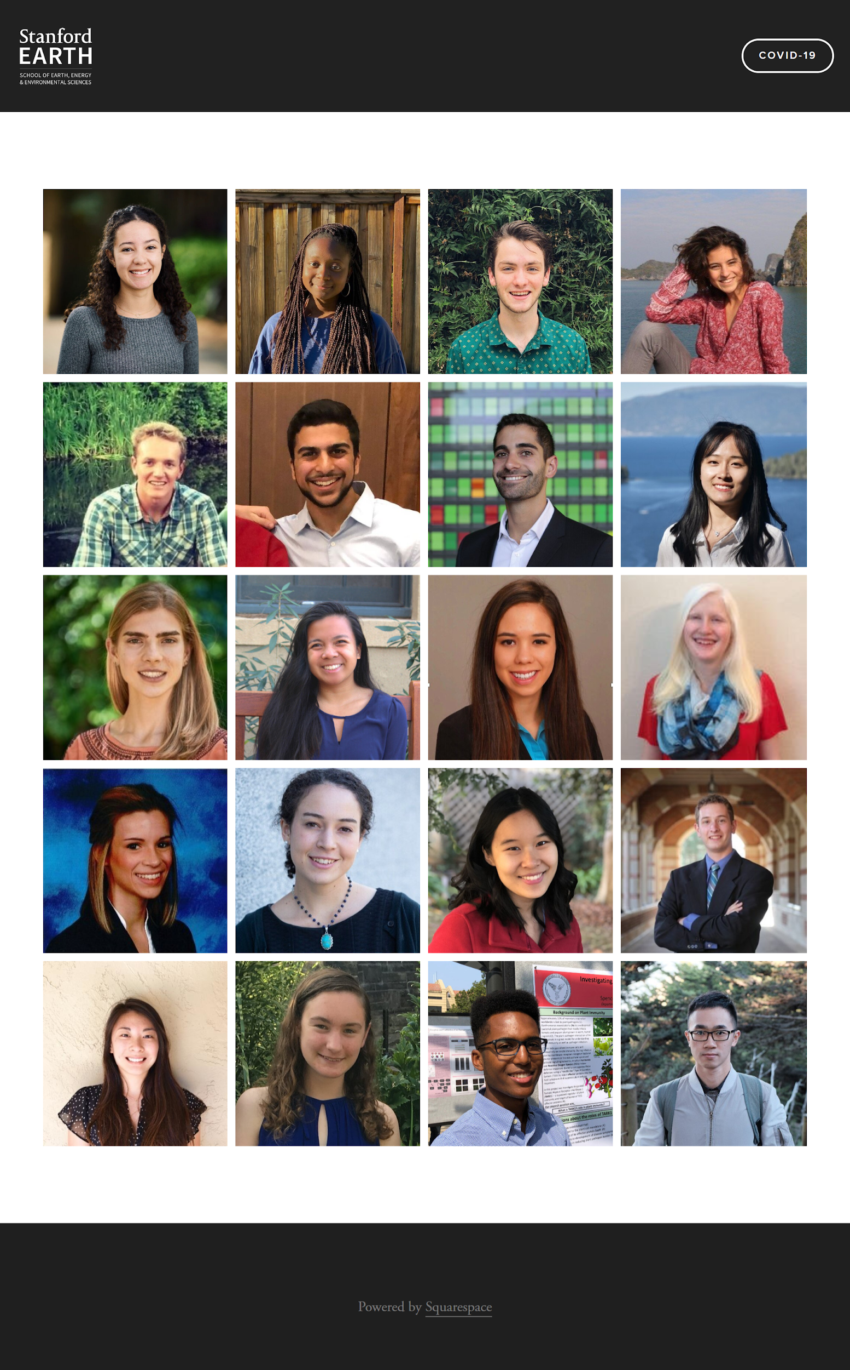
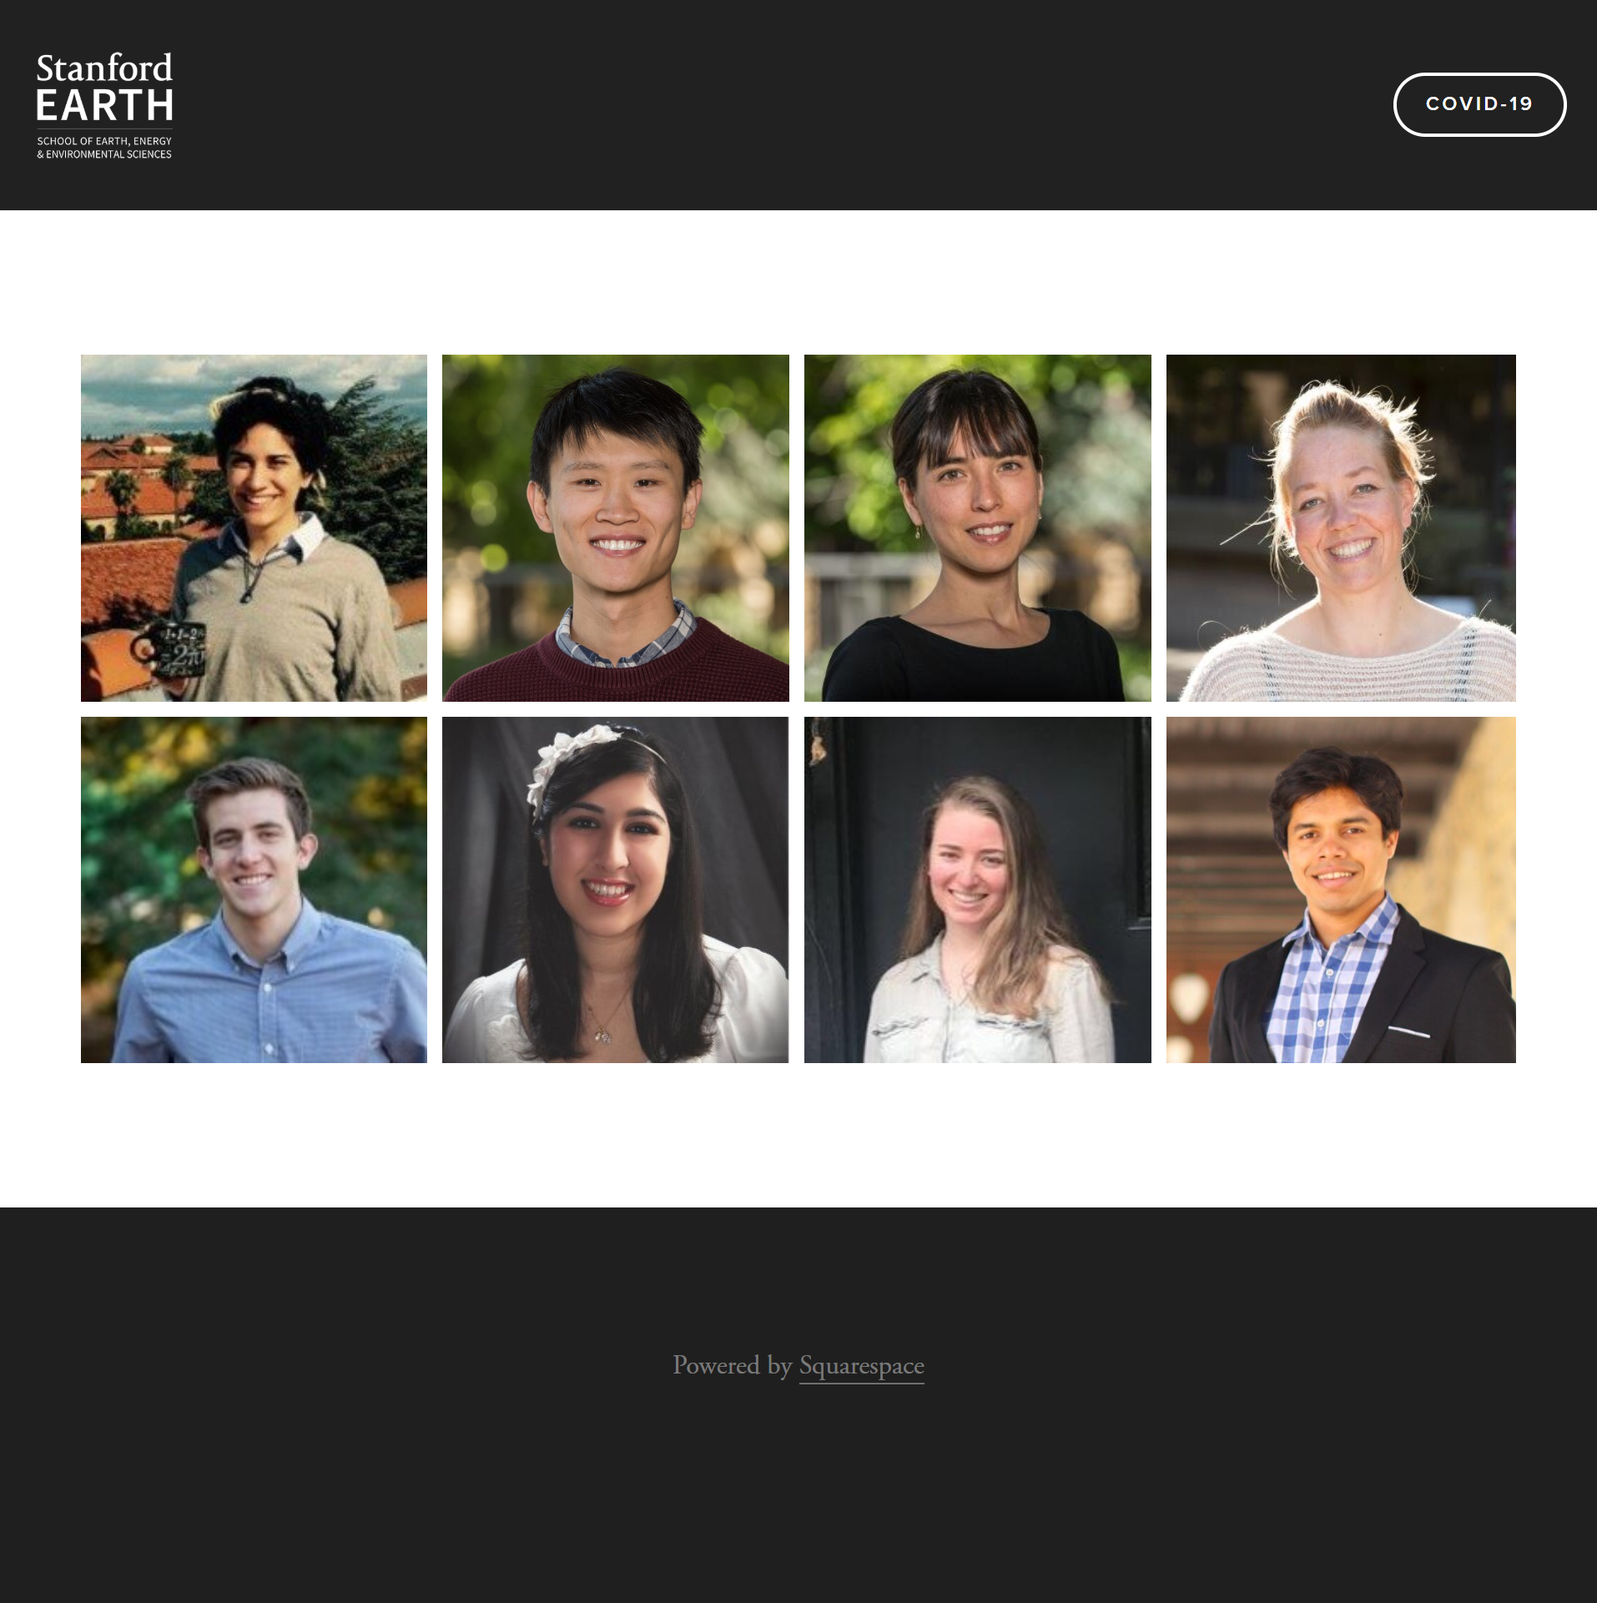
Research Steering Committee
SPRING 2020 PRACTICUM
COVID-19 RAPID RESPONSE
RESEARCH
Researchers mentor course projects; students gain exposure to skills and opportunities in academic research
Researchers gain exposure to real-world stakeholders, problems, and data; community partners guide problem-focused research
Principal Investigators
Prof. Jenny Suckale
Prof. Gabrielle Wong-Parodi
Research Assistants
Postdoc Student
External Partners
Committee
Nonprofit
City
County
Agency
Industry
EDUCATION
PRACTICE
Education Steering Committee
Students
Practice Steering Committee
Teaching Assistants
Derek Ouyang
Partnership Navigator
Students learn from and support community partners;
partners provide career pathways

Slide 55
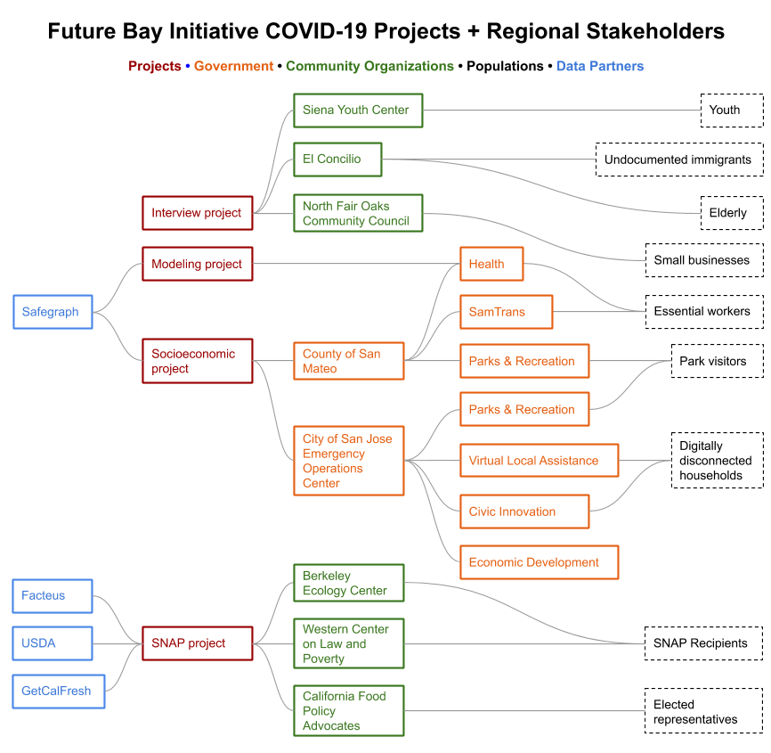
SPRING 2020 PRACTICUM
COVID-19 RAPID RESPONSE

Slide 56
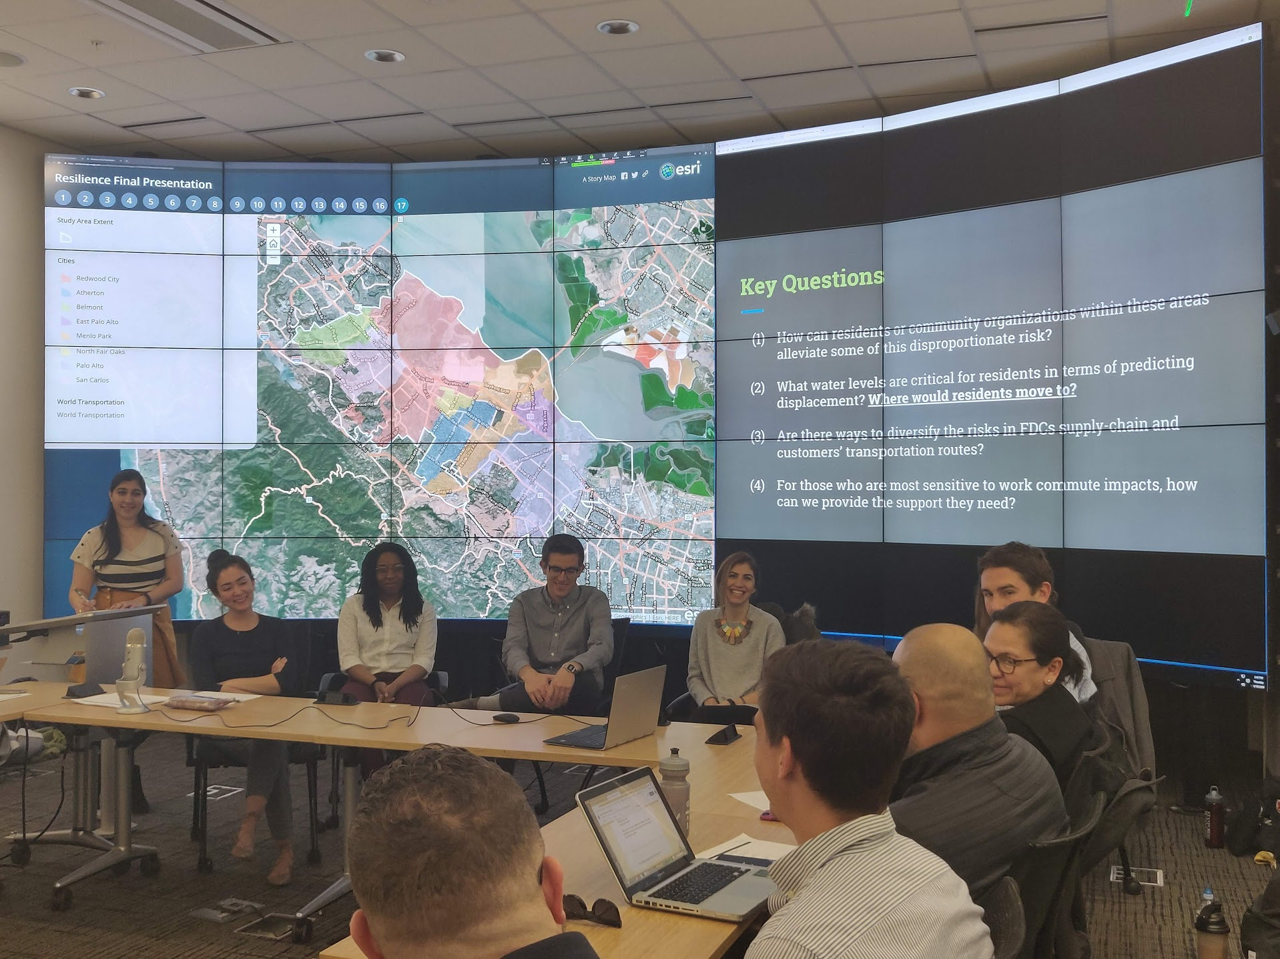
Presentation by Stanford students to community stakeholders, on Stanford campus

Slide 57
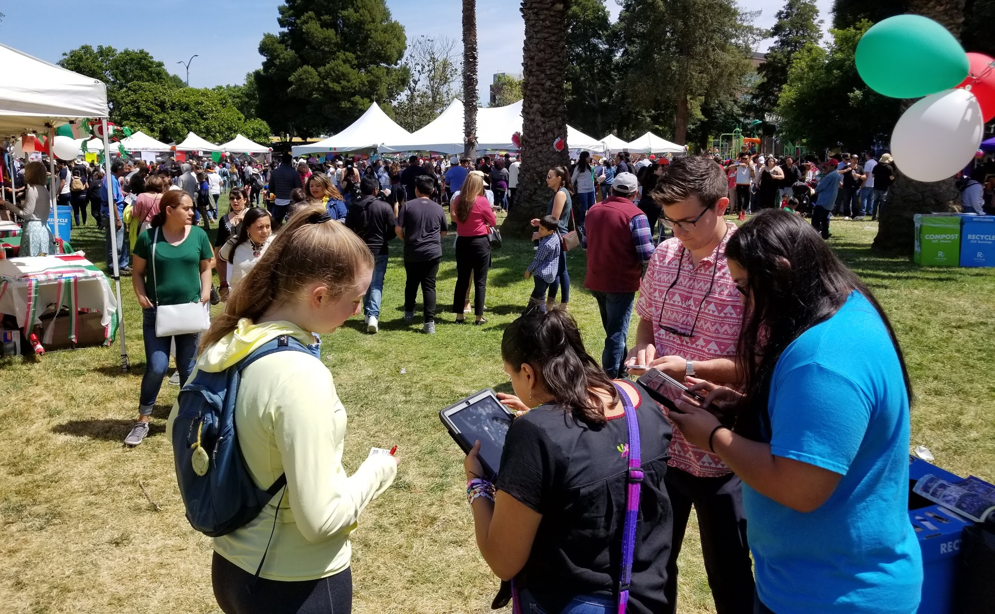
Stanford students supporting a local nonprofit in survey collection at a community event

Slide 58
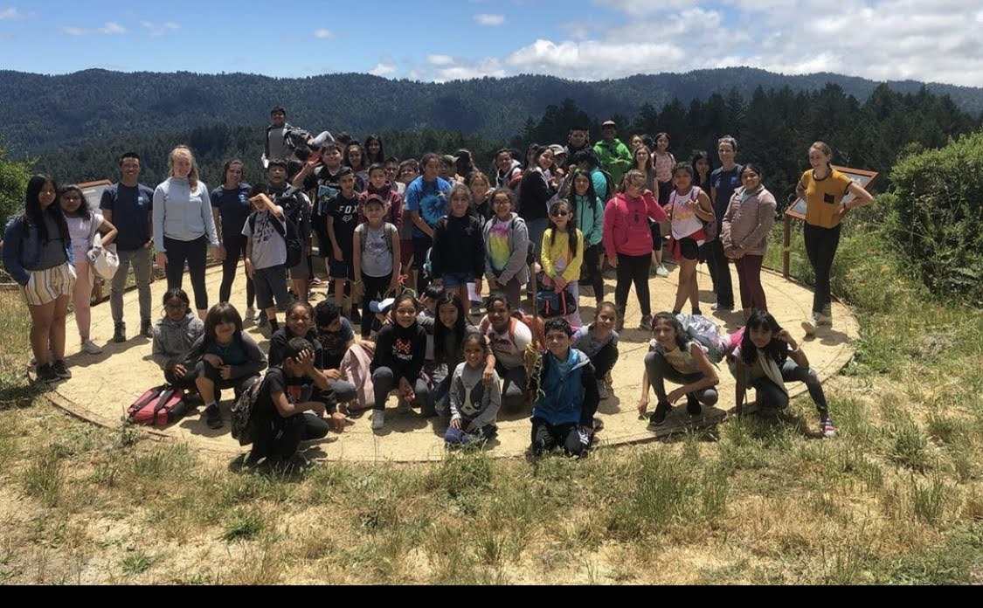
Siena Youth Center environmental curriculum summer field trip, with Stanford students supporting

Slide 59
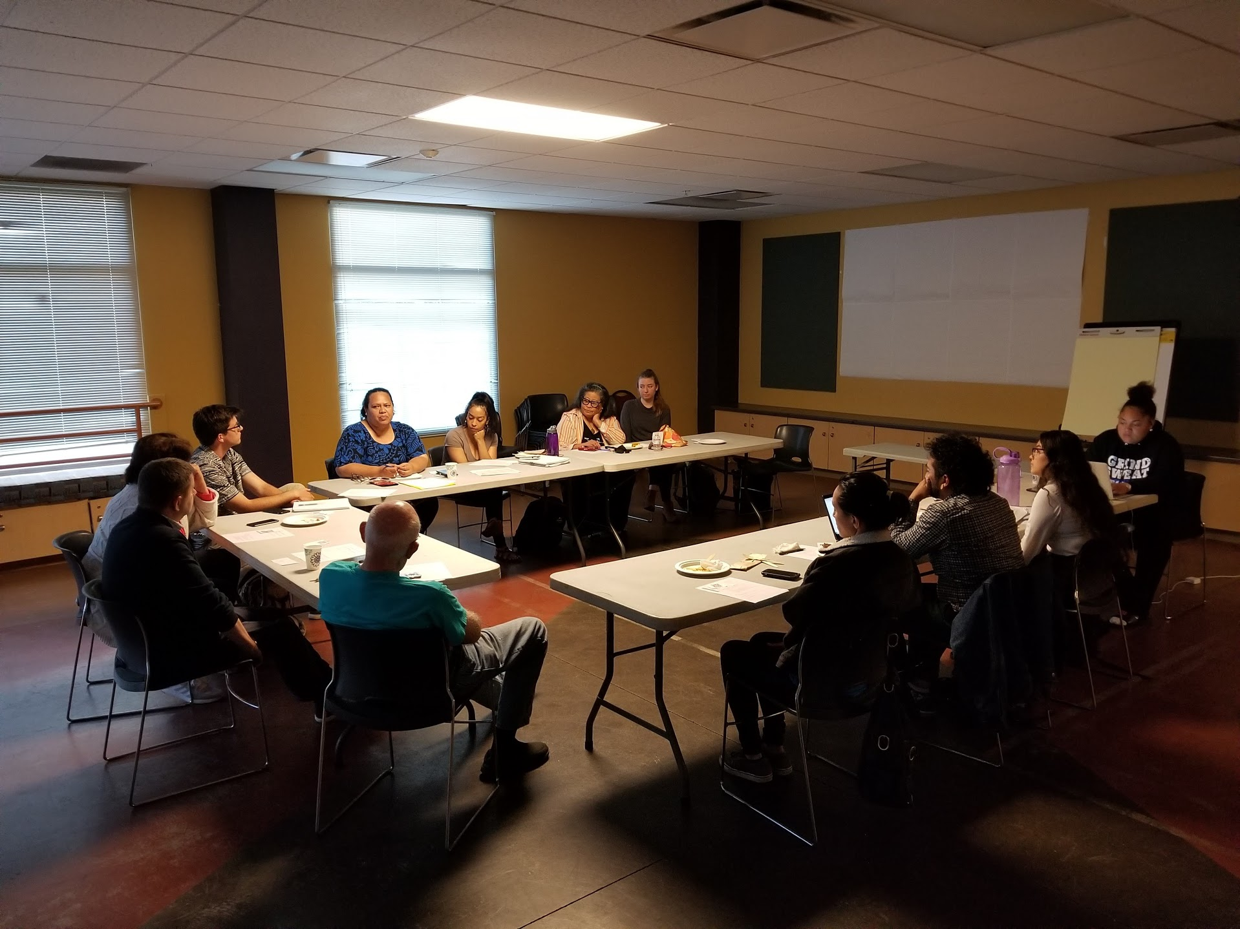
East Palo Alto Climate Change Community Team meeting, with Stanford students in attendance

Slide 60
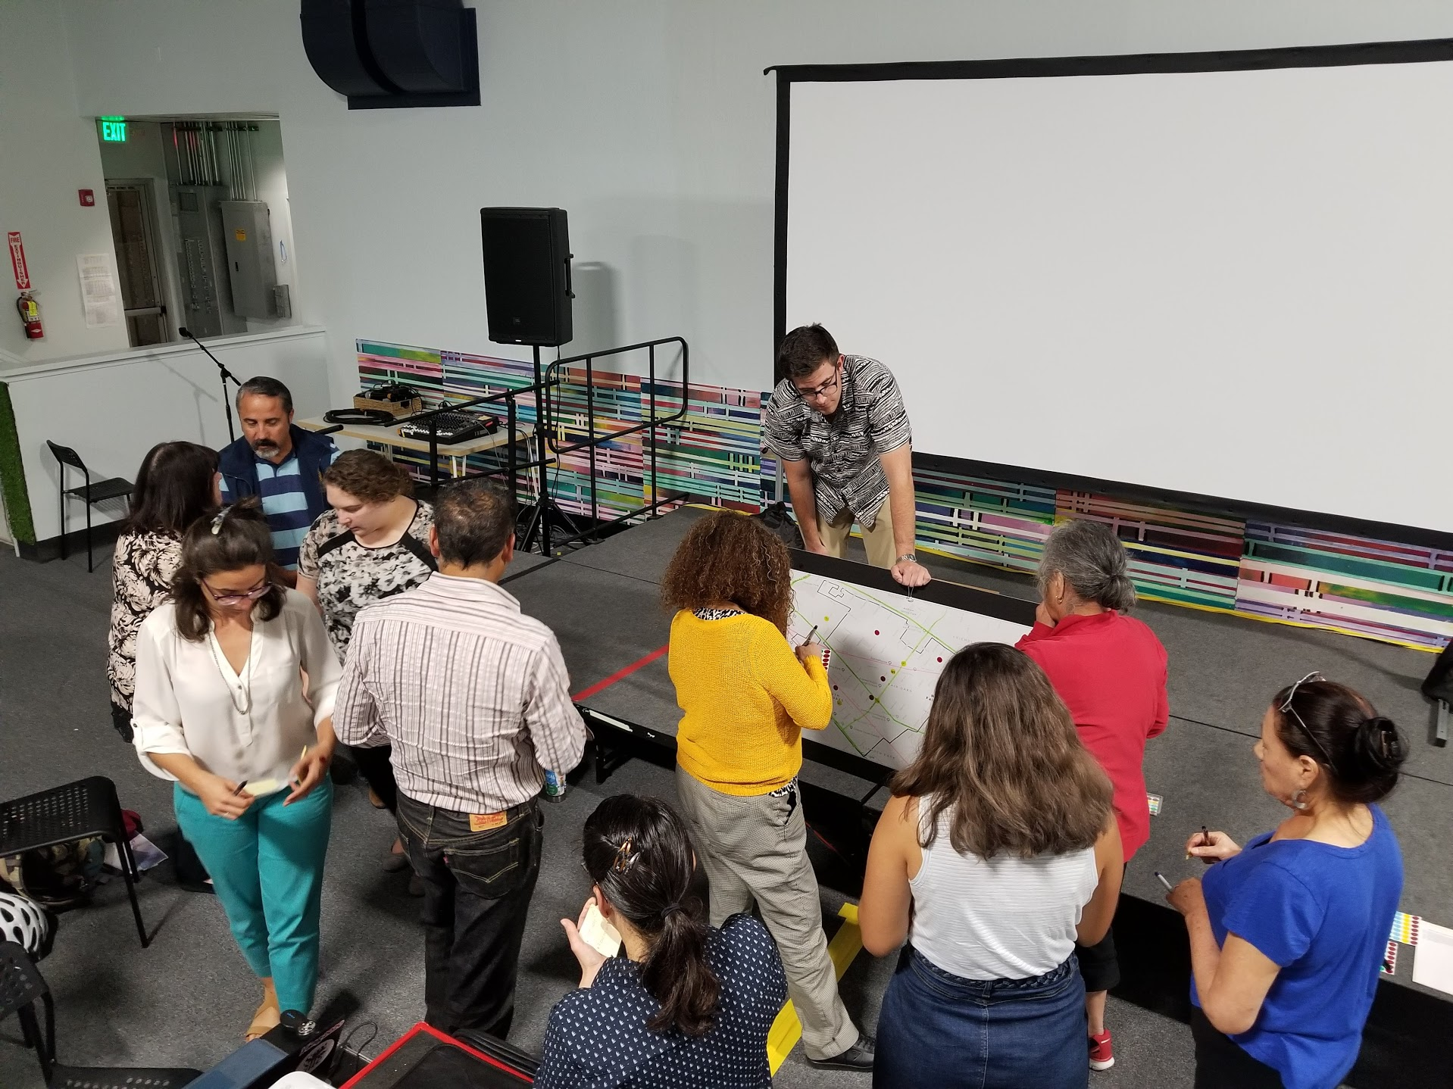
Climate Ready North Fair Oaks, modeled after EPA’s team, with Stanford students, Belen in attendance

Slide 61
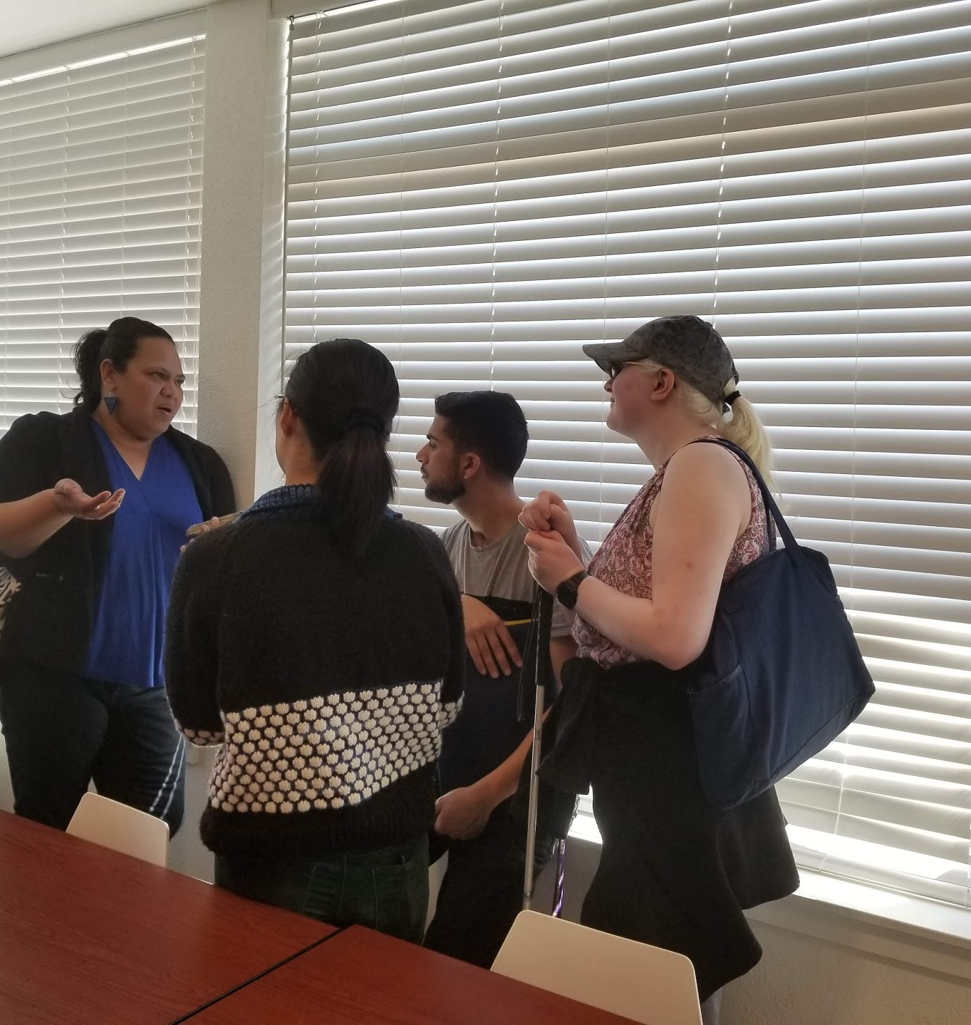

Most recent EJ work on climate + substandard housing in NFO, students engaged Violet, Belen, and others

Slide 62
Outline
Brief intro: Belen’s organization, SMC Health
Brief intro: Derek’s program, Future Bay
Three major challenges Belen and Derek want to highlight
  Authenticity: The need for practitioners within academia, and the intellectual/cultural humility to understand and target root causes
  Accountability: Finding the sweet spot of student engagement, and sustaining partnership through institutional change
  Autonomy: The need for discretion to adapt as needed, from all sides
Conclusion: steps toward structural solutions at Stanford

Slide 63

Belen and Derek at a panel for a housing conference, engaging with stakeholders outside of day-to-day work

Slide 64

2014, Derek first connecting with Stockton partners on community-engaged projects

Slide 65

2019, students continuing to engage with Stockton partners

Slide 66

Violet presenting to NFO partners. Eventually multiple parties worked together to win SVCF funding for NFO.

Slide 67
Miscellaneous: on remote engagement

Slide 68


Digital collaboration...

Slide 69


Digital inclusion...
Another SJ project to optimize installation of broadband

Slide 70


… Digital community

Slide 71
A 15-year multi-sector model for
community engaged learning
Katherine Cushing, Executive Director

Slide 72



Learning, Engagement, and Community Benefits since 2005
SJSU
Students
Engaged
22,000
120,000
San Jose Residents
Engaged
Hours
421,200
Value
$8,802,000

