Slide 1
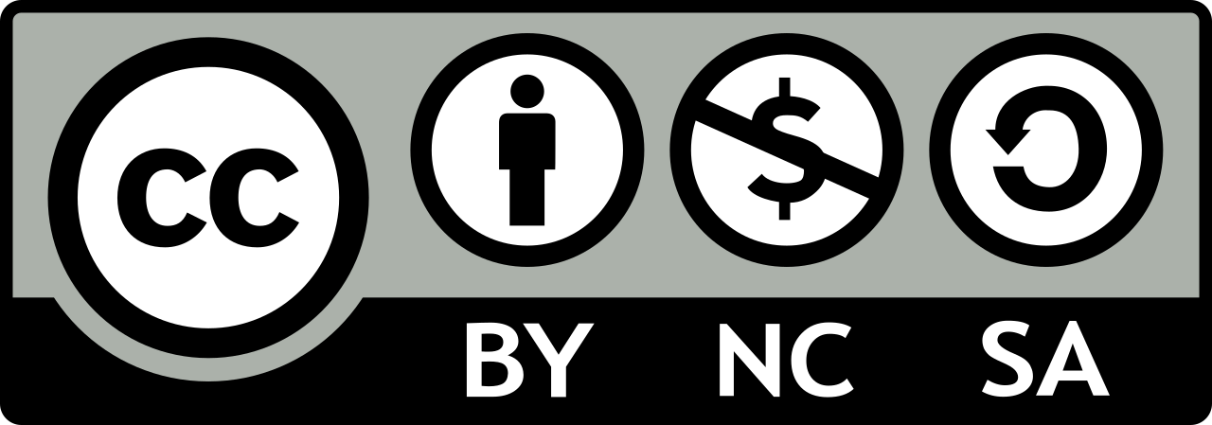
Sustainability Teaching Slides
These slides can be used to teach the concept of sustainability.
Feel free to add adapt them for your courses, crediting the Santa Clara University Center for Sustainability.
Questions? Contact Chad Raphael (craphael@scu.edu)
Santa Clara University Center for Sustainability

Slide 2
Slides to Use in Class

Slide 3
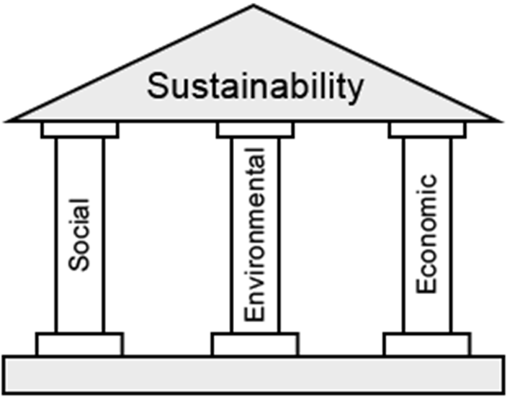
What is Sustainability?
"Development that meets the needs of the present without compromising the ability of future generations to meet their own needs."
- Brundtland Report (1987)
Notes:
The classic definition of sustainability is from the United Nations’ 1987 Brundtland report, Our Common Future.
The three pillars of sustainability are: economic vibrancy, environmental health, and social development or social justice (there has been much debate about which, and the difference matters). “Social development” is often limited to raising basic standards of living above poverty thresholds. “Social justice” is also concerned with equitable distribution of wealth and power.

Slide 4
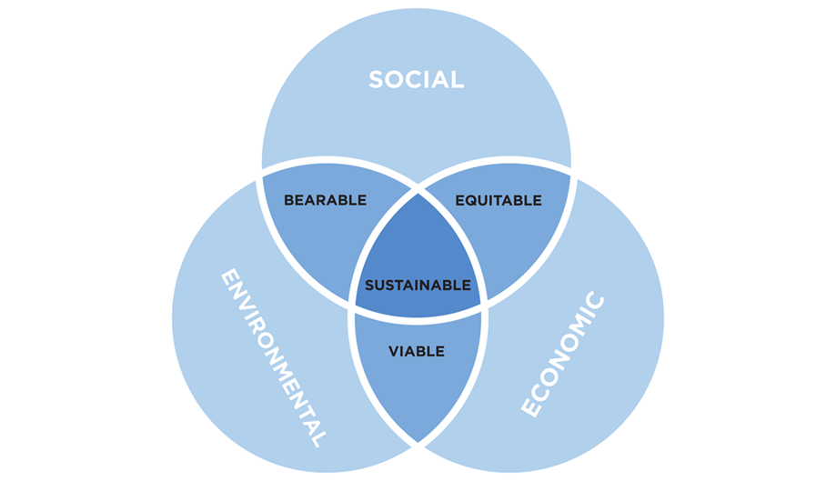
Why All Three Pillars Matter
Notes:
The logic is that all three pillars are required for a sustainable society over the long run. If two of the pillars are strong in a society that’s better than nothing, but not sustainable.
•Social + Environmental: A society may be bearable, but a low standard of living because of lack of economic vitality will eventually cause pressure for more economic development that isn’t environmentally sustainable.
•Social + Economic: A society may be equitable, but collapse eventually because it will deplete its natural resources.
•Environmental + Economic: A society may be viable, but the inequity will have to be resolved to avoid social strife that ends up harming its economy and environment (through terrorism or civil war, for example).

Slide 5
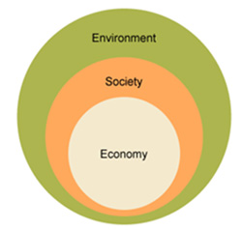
Why the Pillars are Interdependent
Notes:
Another way of thinking about sustainability emphasizes how its three dimensions are interdependent in another way. In this view, the economy exists within society because economic activity requires interaction among people and organizations.
Society is the larger context of the economy because society also includes family, friendships, and cultural activities that can’t be reduced to the exchange of goods and services.
In turn, society and economy exist within the environment because all economic and social activity depend on air, water, land, food, energy, raw materials. Everything exists within the environment.

Slide 6
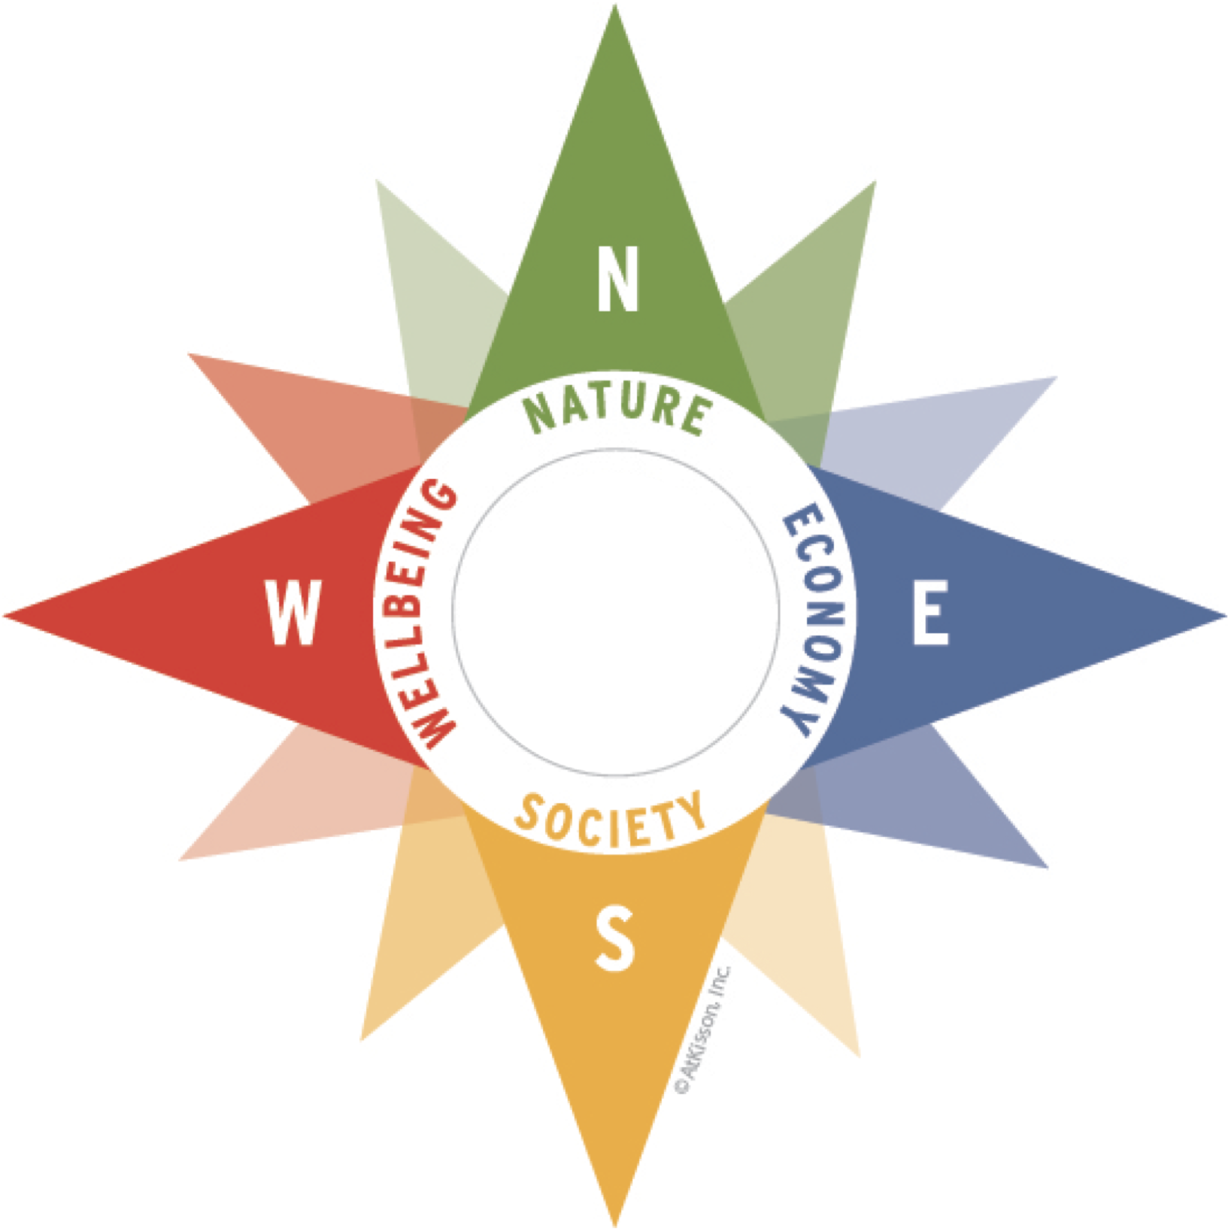
Sustainability Compass - Adding Wellbeing
Nature: ecological systems and environmental concerns, from ecosystem health and nature conservation, to resources and waste.
Economy: human systems that convert nature’s resources into food, shelter, ideas, technologies, industries, services, money and jobs.
Society: institutions, organizations, cultures, norms, and social conditions that make up our collective life as human beings.
Wellbeing: individual health, happiness, and quality of life.
Notes:
The Sustainability Compass adds wellbeing to the definition.
It’s easy to remember because it mimics the points on a compass: North, South, East, and West.

Slide 7
Why Learn about Sustainability?
Systemic Thinking
Notes:
Like all important concepts, sustainability is controversial. It’s often critiqued for not fully valuing one or more of its elements, especially the environment and social justice, but also for slighting the rights and needs of animals, plants, and the earth.
Why do we still encourage you to teach about it?
Because it’s an important concept that’s widely used around the world, even if it can be defined differently, including by you.
Because models like the ones on this slide, or ones you might create, help students to think multidimensionally about the major challenges we’re facing. Probably the most important thing we can teach our students about sustainability is how every significant change in the economy, society, or environment affects all of the other spheres. If we can do that, students will be much better equipped to design and deploy technologies, policies, artworks, scientific theories, and cultural trends. They’ll also be better equipped to vote on how to subsidize, legislate, and regulate, and to make personal choices about whether and how to consume.

Slide 8
Implementing Sustainability Goals
United Nations - Sustainable Development Goals Project Drawdown - Global Climate Solutions Vatican - Laudato Si’ Action Plan goals and University Pathways goals
UN Environment Programme Finance Initiative - Banking, insurance, and investing principles + standards
Second Nature - University Presidents’ Climate Leadership Commitments Real Food Challenge - Real Food Standards and Calculator Climate Justice Alliance - Just Transition Framework
GoodElectronics/ICRT - Chemical Challenge to the Electronics Industry
Notes:
Here are some sets of goals, solutions, or commitments that implement sustainability in ways that can be applied and measured.
They are presented in order from the general to the specific. The UN’s SDGs address many ways to implement sustainability, while the Real Food Challenge and Chemical Challenge focus on achieving sustainability in specific areas, such as the food system and electronics production. SCU has signed on to the University Presidents Climate Leadership Commitments.
[Which goals, solutions, or commitments does your lesson plan, module, or course address?]

Slide 9
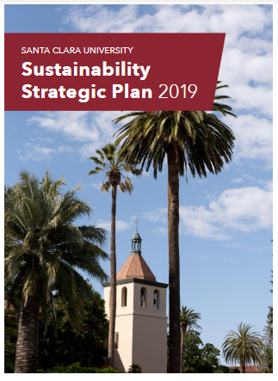
SCU’s Sustainability Strategic Plan
Video
Plan
Playbooks
Notes:
Institutions, including SCU, also implement sustainability.
Watch the short video introducing the plan.
See the full plan and the playbooks for different constituencies (faculty, students, etc.)
[How does the SCU Sustainability Strategic Plan apply the three pillars of sustainability? How does it apply the UN’s Sustainable Development Goals?]

Slide 10
Sustainability – Catholic + Jesuit
Laudato Si’
Ethics and Pope Francis’s Encyclical Letter Laudato Si’: A Teaching Module
Laudato Si’ Action Plan and University Pathways
Notes:
[Those of us who teach at Catholic or Jesuit institutions can also look for inspiration in the module for teaching Pope Francis’s Encyclical Letter, Laudato Si’. How might your course address any of the main themes in the encyclical?]

Slide 11
Slides to Help You Design Your Lessons, Modules, & Courses

Slide 12
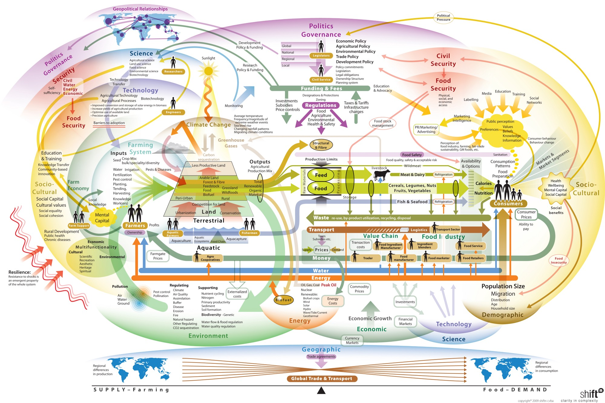
Sustainability Goals + Your Course
You can’t teach everything about sustainability
Teach students the habit of thinking three-dimensionally about how the environmental, economic, and social interact
Teach how to apply this thinking to your field and course material
Avoid overwhelming students with a diagram like this one
Notes:
Sure, everything is connected to everything else.
But if you try to create a diagram like this and teach it to your students, they will be overwhelmed and unlikely to remember it.
Teach students to think three-dimensionally: get them into the habit of asking how environmental, economic, and social developments interact.
Teach them to apply this kind of thinking to your field and course material.

Slide 13
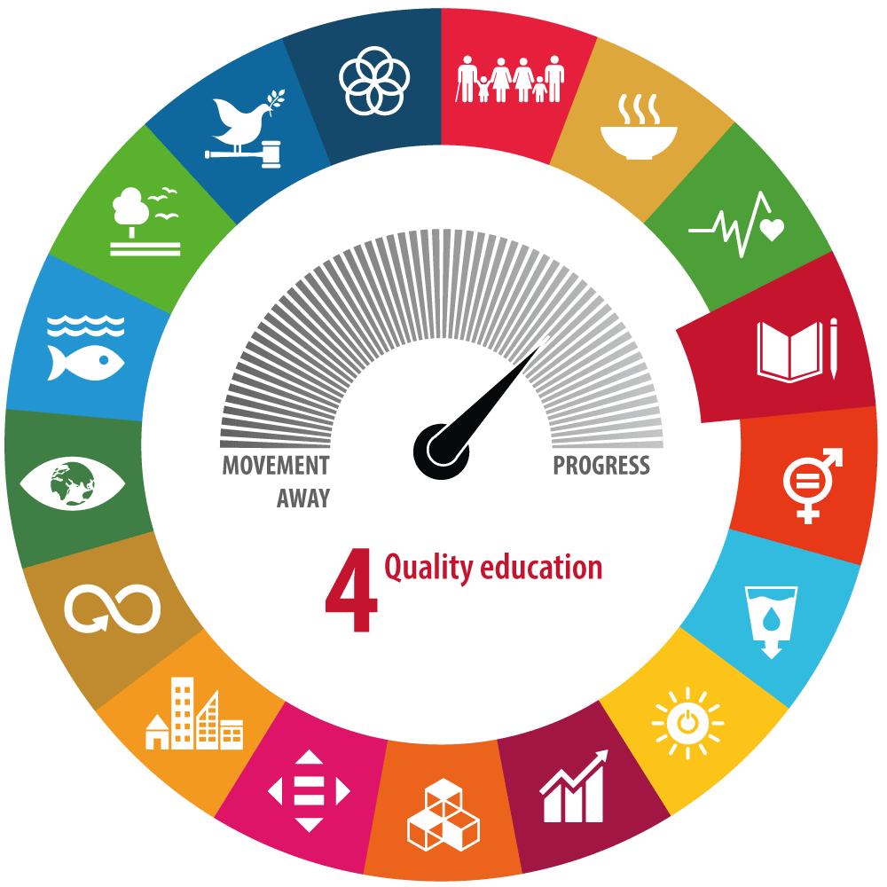
Sustainability Goals + Your Course
Link student learning to larger goals
To motivate students
To help students evaluate solutions
To help students make meaningful contributions
Notes:
Wherever you find inspiration, the aim is for you and your students to understand how what they’re learning in your course will help them contribute in specific and valuable ways to sustainability in the world.
Most students are hungry for solutions and eager to act. As instructors, we can help them evaluate the pros and cons of solutions, and learn to take action as professionals in their fields, as global citizens, and as individuals and consumers.

Slide 14
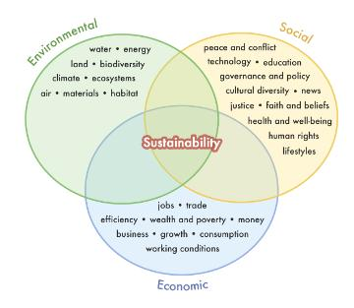
Sustainability Definitions
Which connections do you want your students to make?
Notes:
Here are some of the many ways that education for sustainability integrates learning about environmental health, social development/equity, and economic prosperity.
When designing your lesson plan or module, think about which connections among these dimensions of sustainability you want your students to make.

Slide 15
Sustainability Learning Outcomes
What do you want students to be able to know and do?
Notes:
Then think about what you want your students to be able to know and do. These are your learning objectives.

Slide 16
Focal Questions
Environmental, social, economic
What are the likely costs and benefits of enacting carbon taxes to combat climate change?
Notes:
Some people prefer to begin by designing the main focal questions they want students to try to answer in their course.
Here are examples of how to write those questions in ways that integrate each of the three dimensions of sustainability.
Economic dimensions are in yellow, social in blue, environmental in green.

Slide 17
Focal Questions
Environmental, social, economic
How was 19th century American landscape photography used to boost tourism in California?

Slide 18
Focal Questions
Environmental, social, economic
How can we design electronics using materials that can be recycled more safely and efficiently?

Slide 19
Focal Questions
Environmental, social, economic
Can a Christian ethics of stewardship adequately protect the environment?

